Slide 1
Background Style Transfer
Zhicheng Ding – computer science
Qingtian Gong – computer science
Yuanqing Hong – computer science

Slide 2
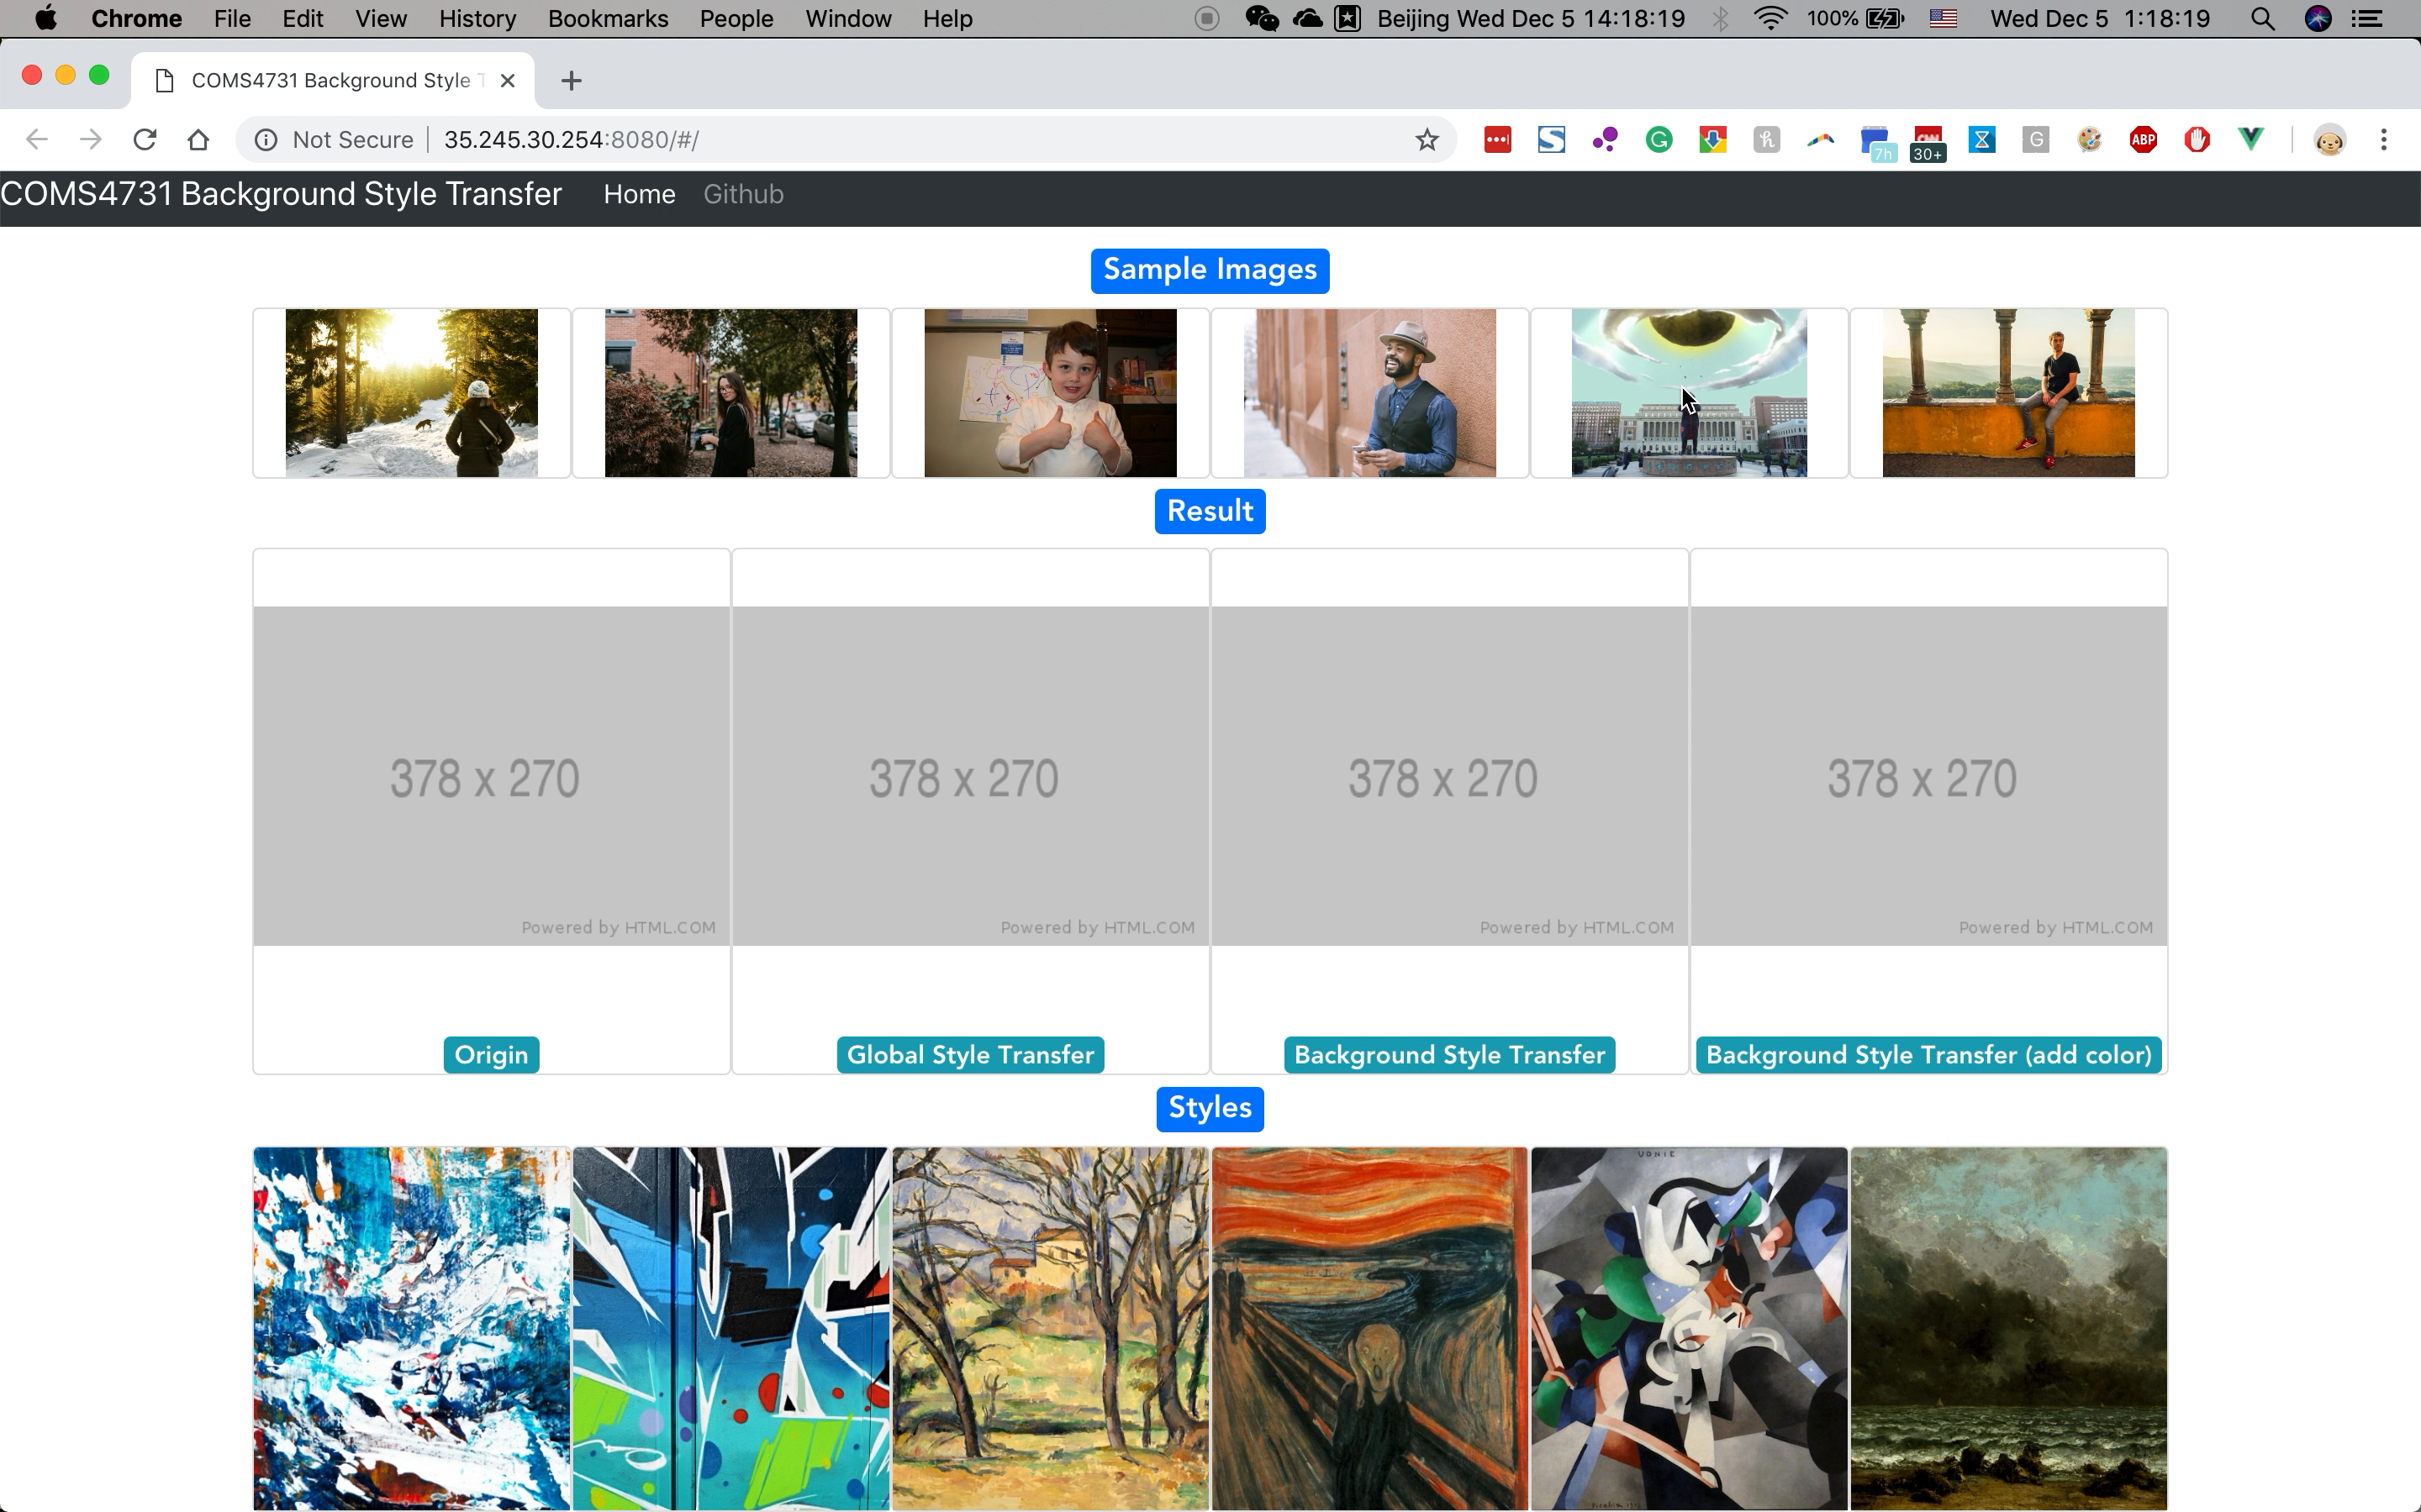
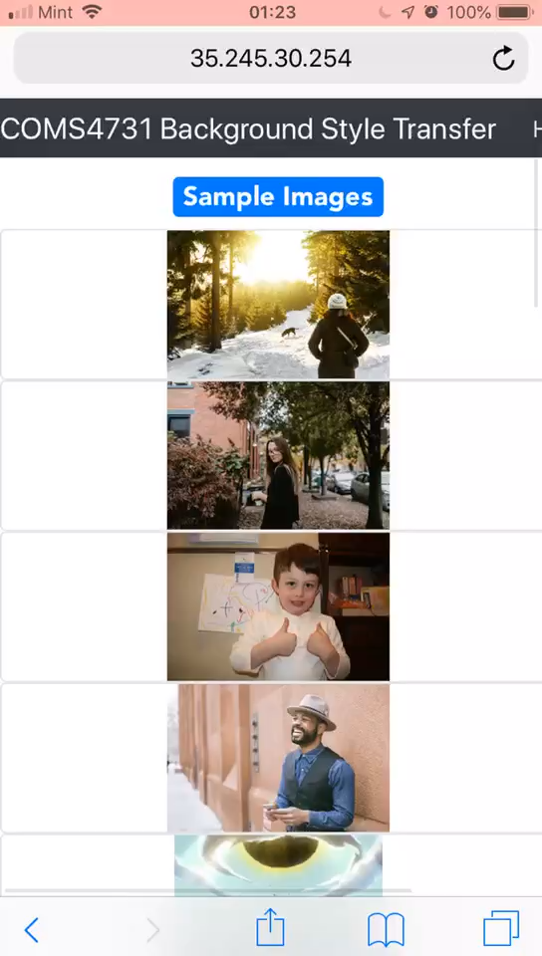
Demo in Web and Cell phone.

Slide 3
Problem Definition and Motivation
Given an original image and a style image, we apply the style to the original image.
Normal style transfer methods apply to the whole image. However, sometimes people want to transfer the abstract style only to the background or specific regions.
Inspired by semantic segmentation, we proposed a method to conduct a regional style transfer.

Slide 4
Input Image
Semantic Segmentation
Style Transfer
Color Transfer
Binary Mask
Global Style Transferred Image
Global Color Transferred Image
Boundary Optimization
Mask
Combine
Web Frontend

Slide 5
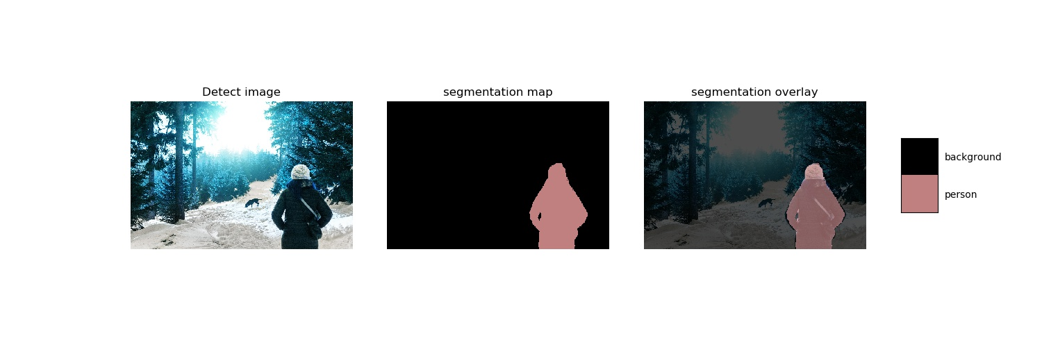
1. Semantic Segmentation
Human recognization
Combines Atrous Spatial Pyramid Pooling (ASPP) module and encoder-decoder structure *
Canny Edge detection for boundary optimization
Gaussian Blur for blending
* Ref: L.-C. Chen, et al. ECCV. 2018

Slide 6

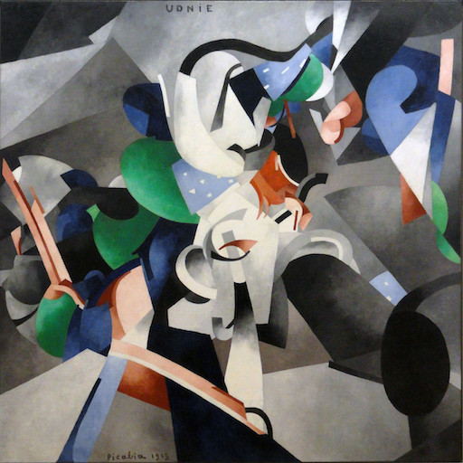
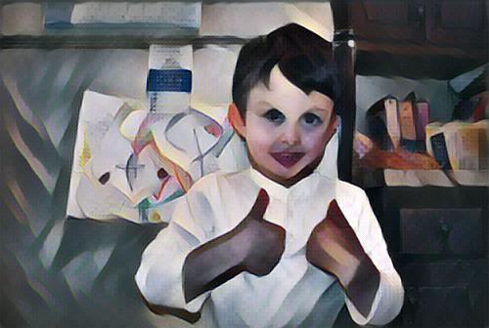
2. Style Transfer
For background
Feed-forward CNN with perceptual loss functions *
* Ref: J. Johnson, et al. ECCV. 2016

Slide 7
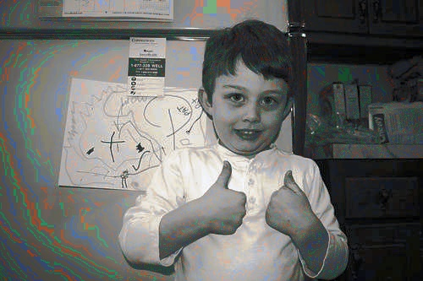
3. Color Transfer
For foreground (i.e. human)
PCA in lαβ color space to map to 1-D lines for both the image and the style
Color transfer according to the relative position on the lines

Slide 8


4. Combination

Slide 9
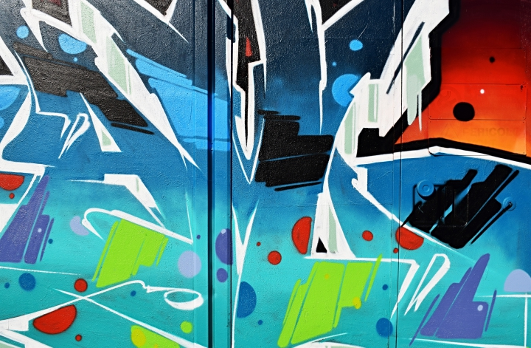


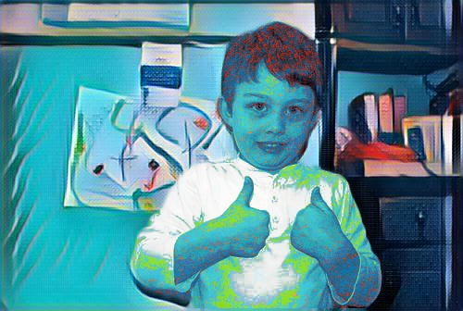
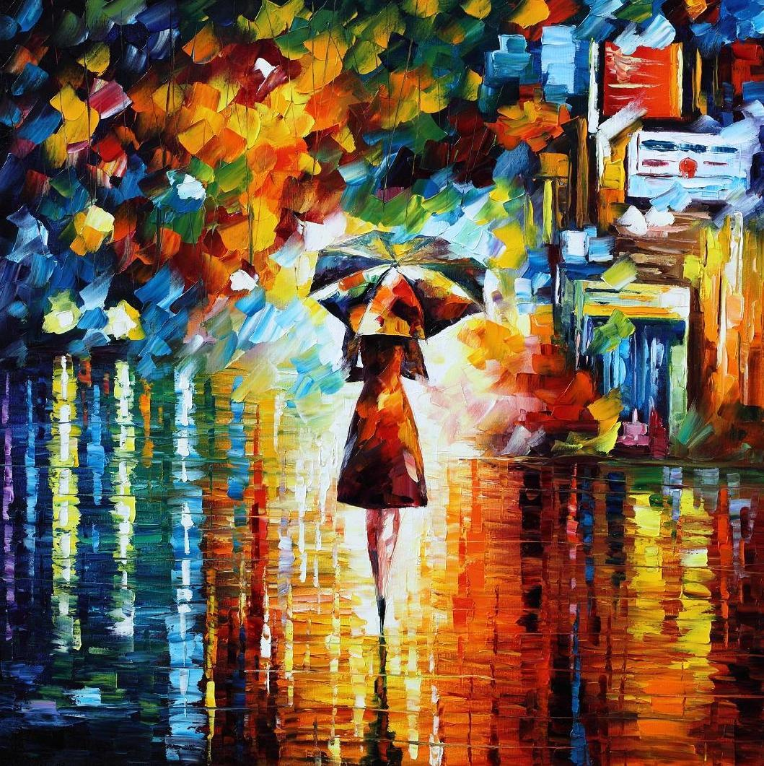



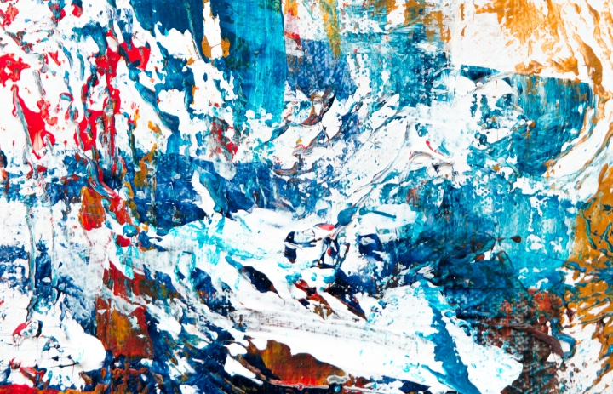

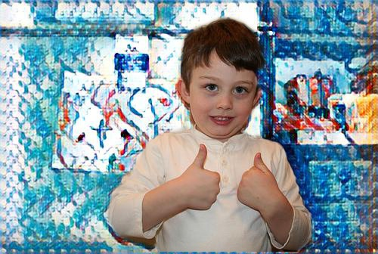
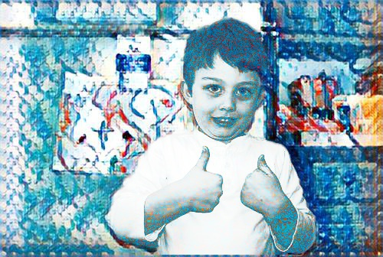
5. Other demo images

Slide 10
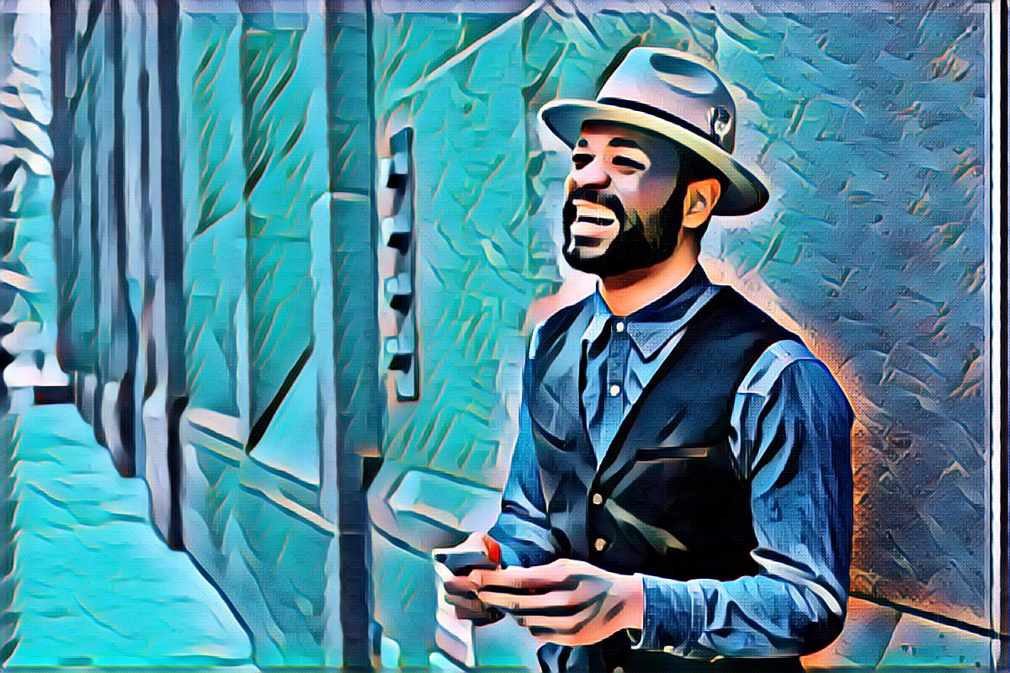
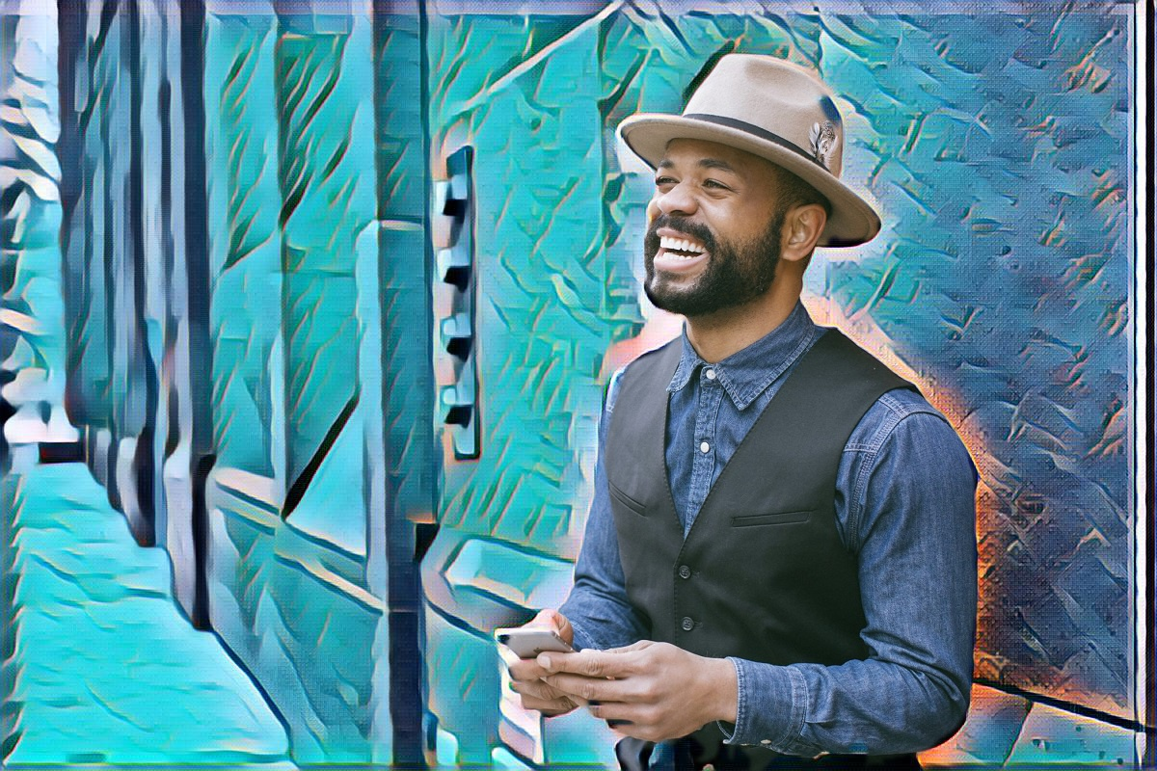
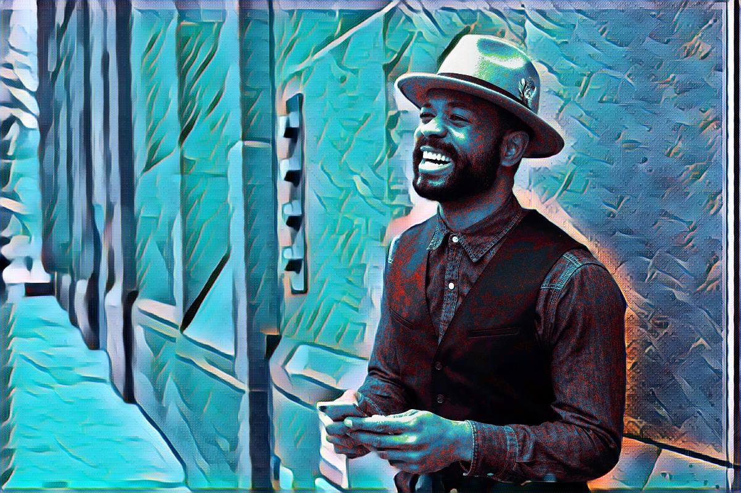
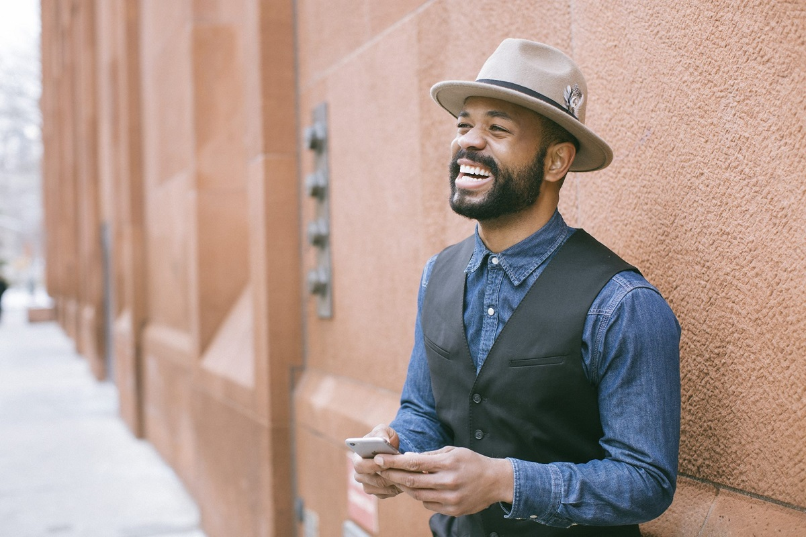
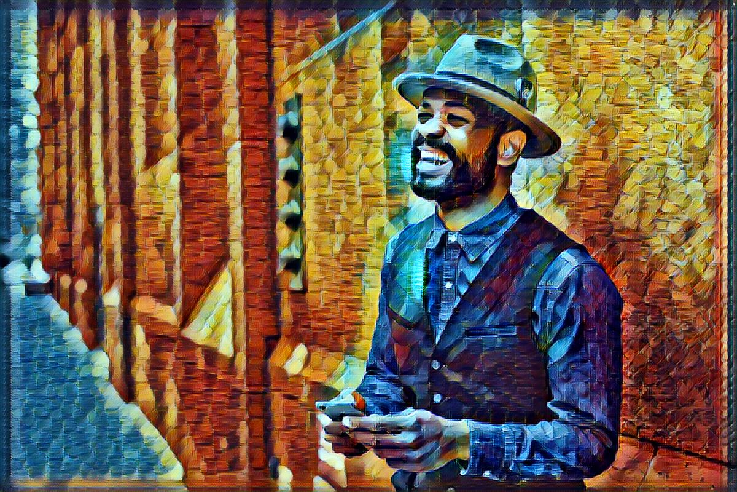
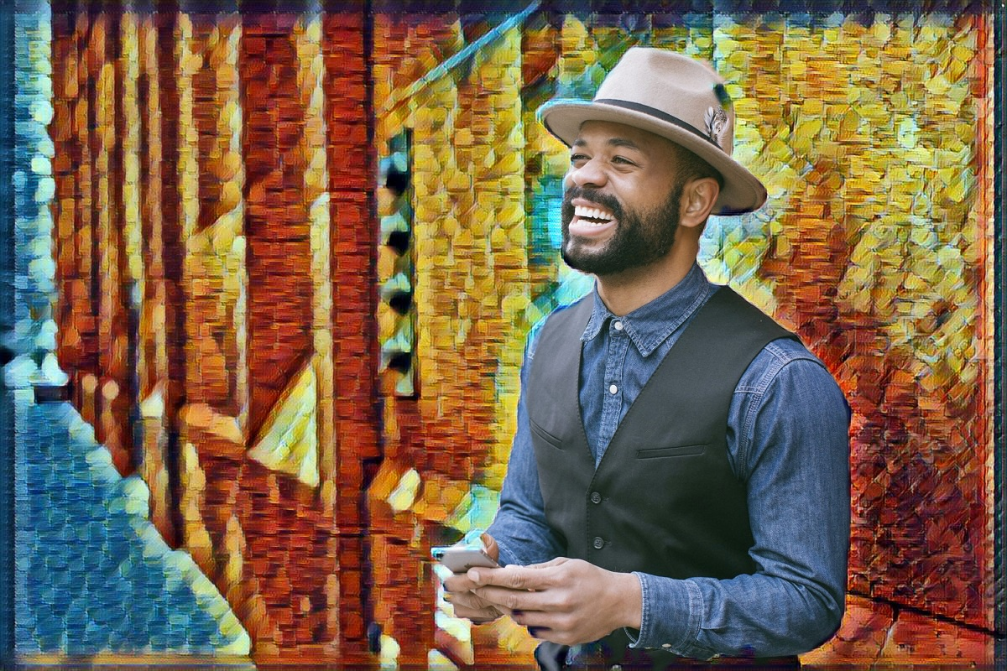
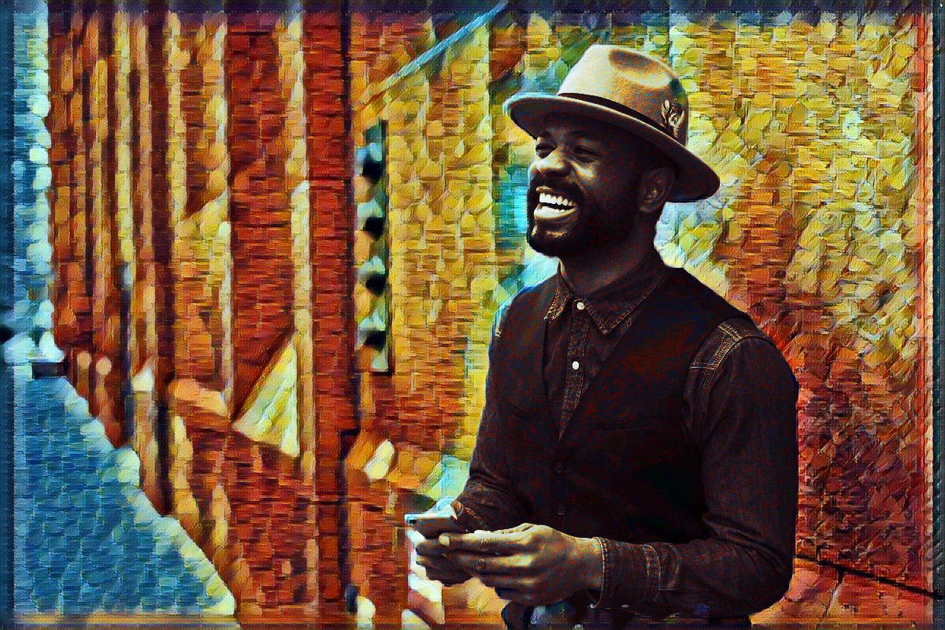
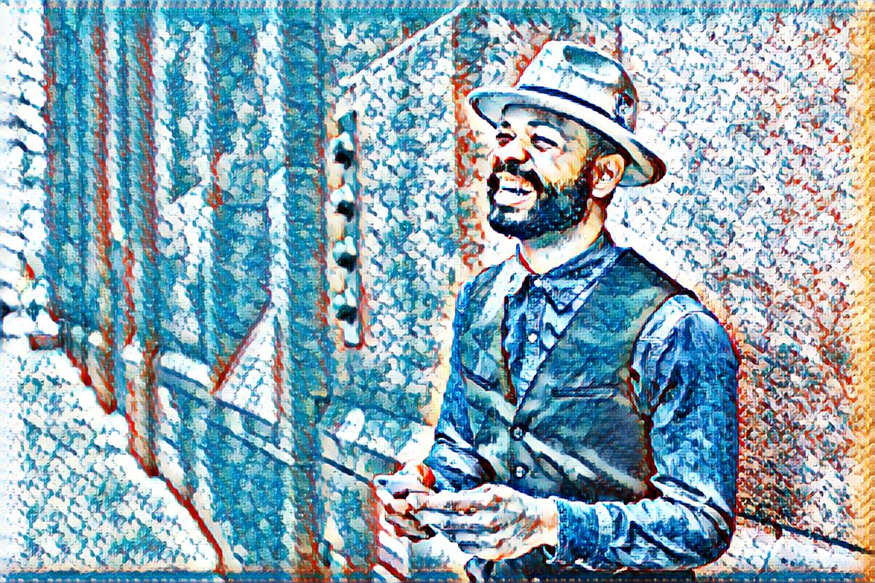
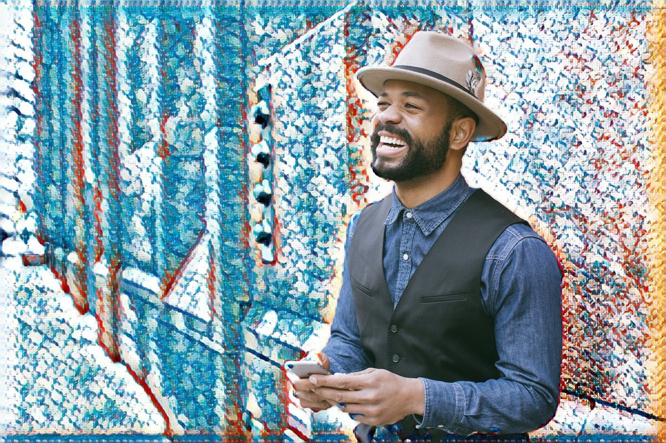
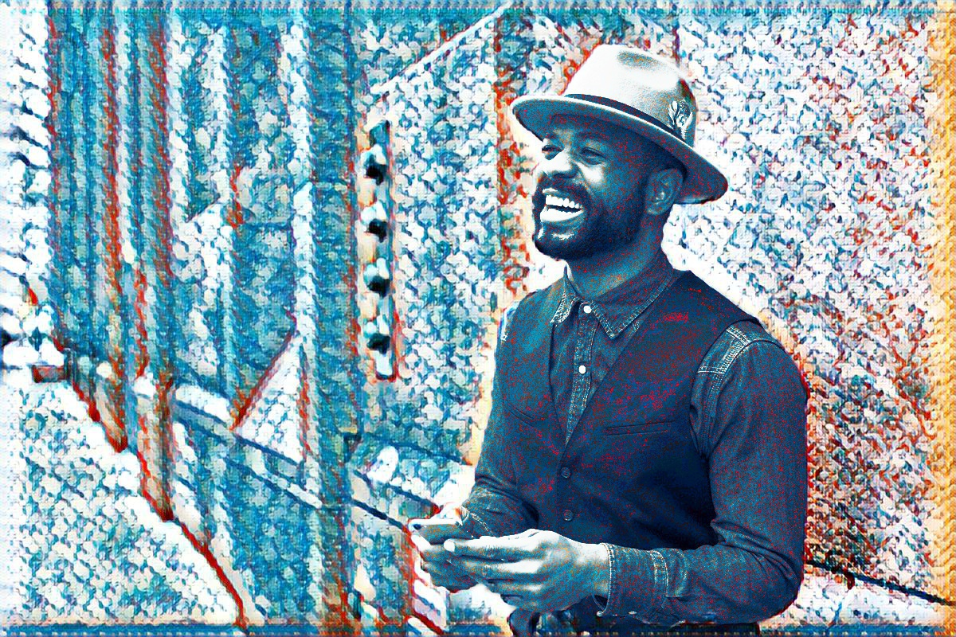
5. Other demo images

Slide 11
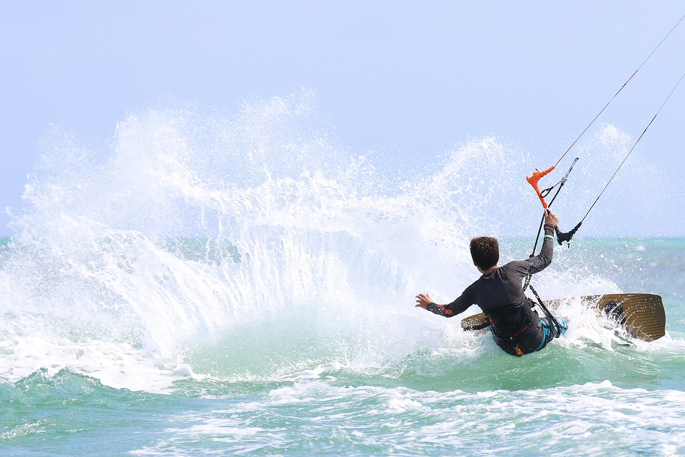

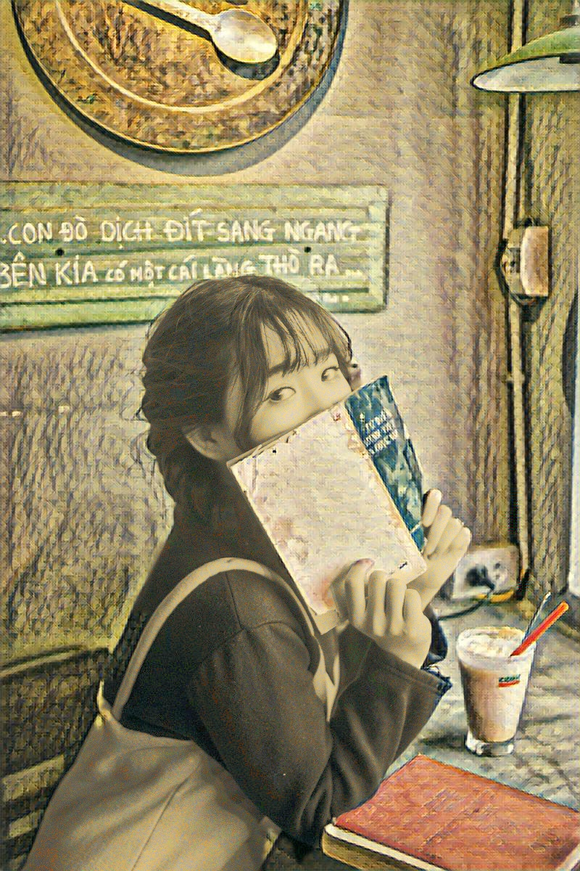
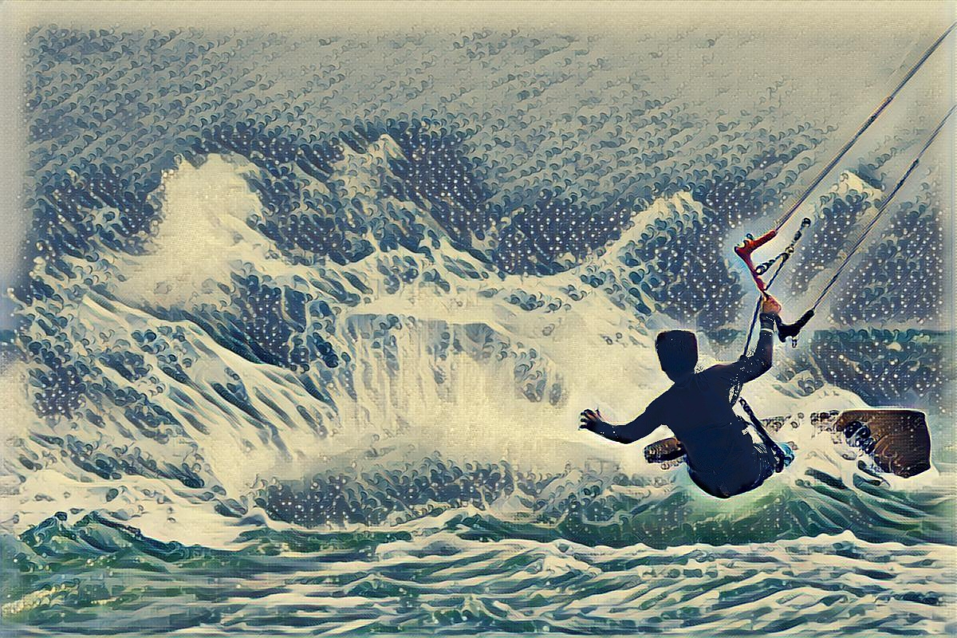
5. Other demo images

Slide 12
Thank you! Demo: http://35.245.30.254:8080/
Notes:
http://35.245.64.0:8080/#/

